Slide 1
DISCRETE MATHEMATICS
Lecturer : Ngeth Youdarith & PHANN Sopheap
Group : 2
Group Member’s Name:
Na Sreypich
Toch Sreynit
Hong Chhievguek
Pen Kanha
Phy Sokmanea
Boa Mouyly
Deob Doungsopanha

Slide 2
Exercise Practies
I. In a group of 105 students
70 students passed Math
60 students passed CCNA
45 students pass Advance Programing
30 students passed Math and CCNA
35 students passed CCNA and Advance Programing
25 students passed Math and Advance Programing
15 passed all subject
Find the number of students who
d. Passed all three subject that they passed two
e. Passed Math given that they passed CCNA

Slide 3
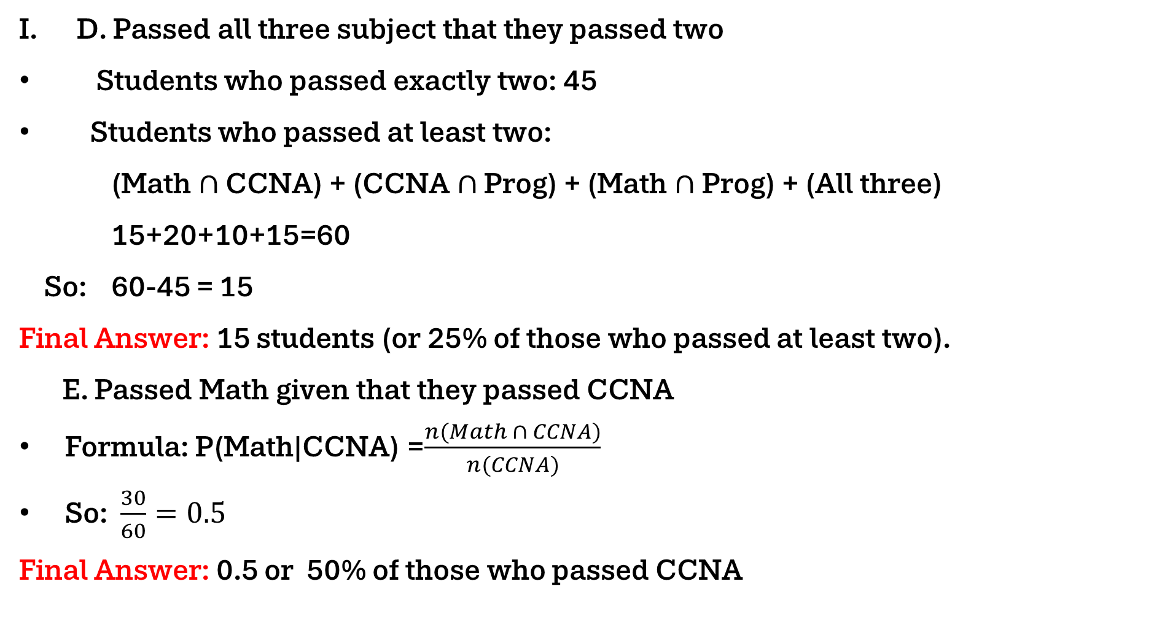
Exercise Practies
D. Passed all three subject that they passed two
Students who passed exactly two: 45
Students who passed at least two:
(Math $∩$ CCNA) + (CCNA $∩$ Prog) + (Math $∩$Prog) + (All three)
15+20+10+15=60
So: 60-45 = 15
Final Answer: 15 students (or 25% of those who passed at least two).
E. Passed Math given that they passed CCNA
Formula: P(Math|CCNA) =$\frac{n(Math ∩ CCNA)}{n(CCNA)}$
So: $\frac{30}{60}=0.5$
Final Answer: 0.5 or 50% of those who passed CCNA

